Slide 1
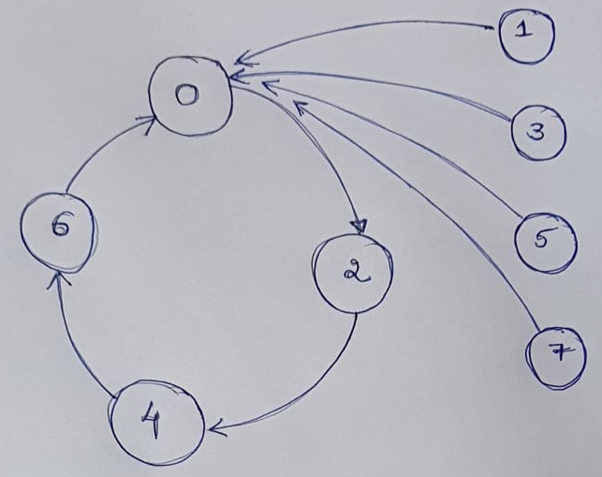
Exp-6
1(a) Design a synchronous arbitrary sequence counter (shown in the below state diagram) using JK flip flops and two input logic gates (if required). Display the outputs on LEDs.
1(b) Design an asynchronous mod-6 up counter using JK flip flops.
RJEs: Remote job entry points

